Slide 1
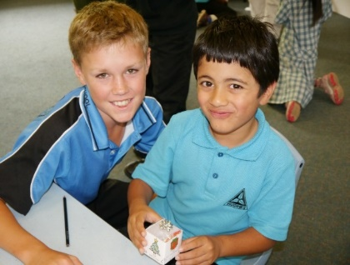
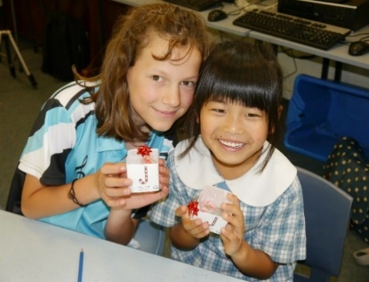
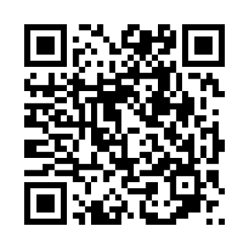
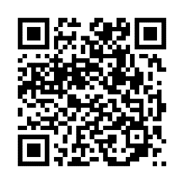
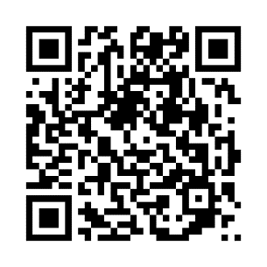
CEIS training is happening soon! Book into any session listed below to discover how you can help children explore God and Jesus.
Monday 22 May 12:30-2:30pm Lifestream Christian Fellowship WANNIASSA
https://www.trybooking.com/CHVVF
Tues 23 May 12:30-2:30pm Hughes Baptist Church HUGHES
https://www.trybooking.com/CHVVL
Tues 23 May 5:00-7:00pm Church of Christ AINSLIE
https://www.trybooking.com/CHVVN
Thousands of children are asking about God. Will you take time to tell them?
P: 6230 5155 W: www.ceis.org.au E: coord@ceis.org.au

